Slide 1
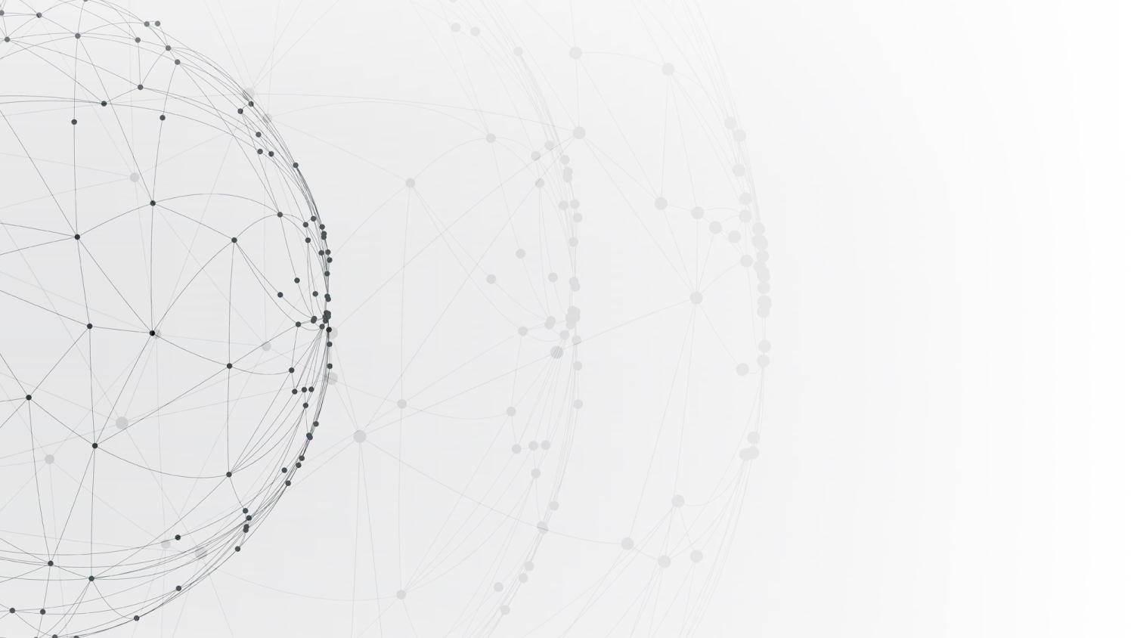
Design of Modern Communication Systems
Application Research on DOA Estimation Based on Software Defined Radio Receiver
Presenters: 12012128 孙逸涵
12011923 张旭东
12011442 周若雨
12011137 陈至越
Date: 2023.05.31

Slide 2
CONTENTS
Introduction
01
02
MATLAB Code
03
Experiment
04
Results & Analysis
05
Conclusions

Slide 3
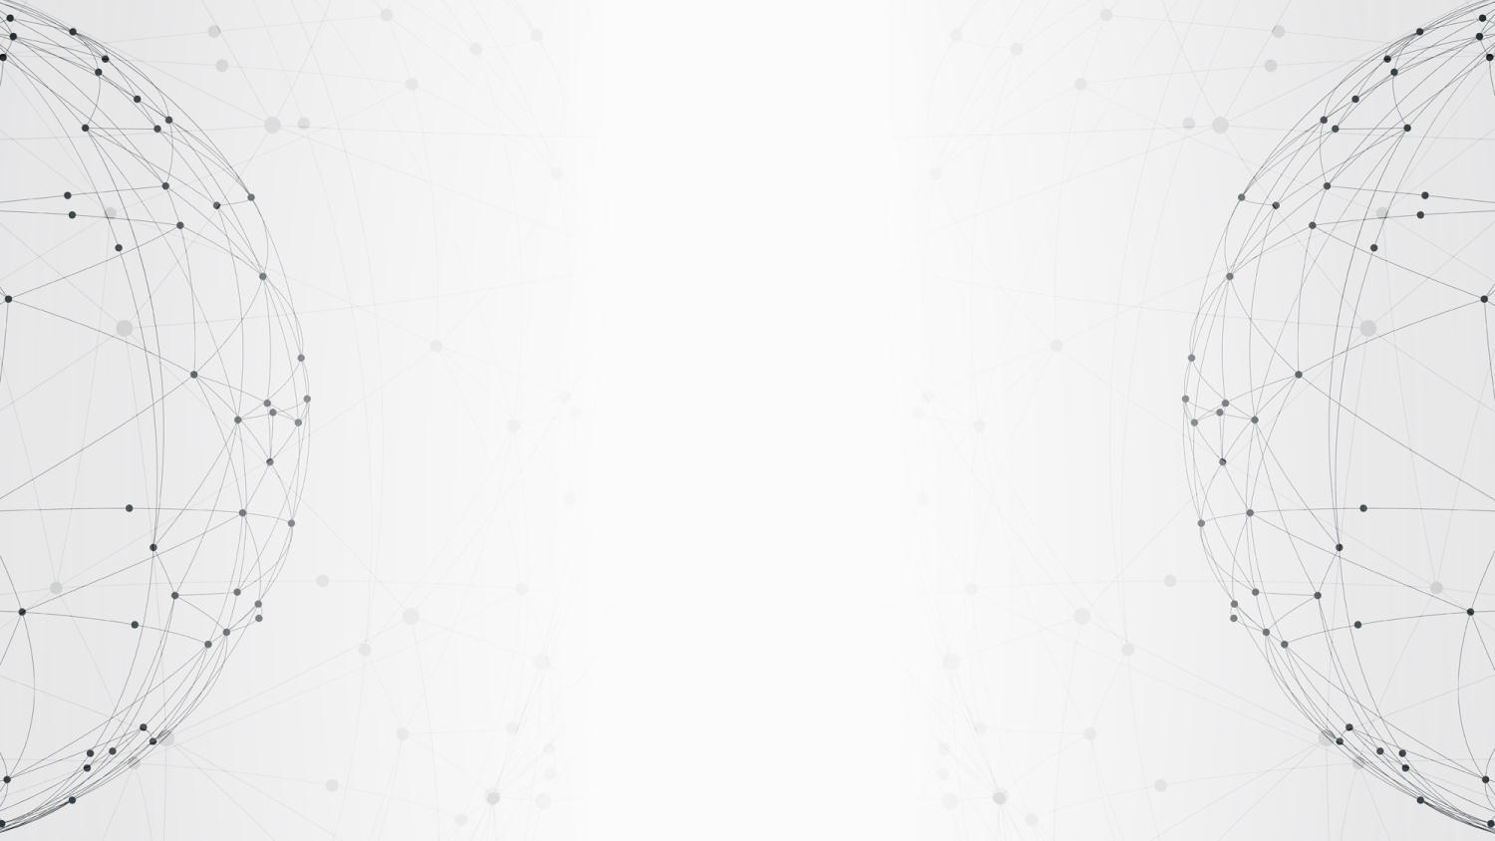
01
PART
Introduction

Slide 4
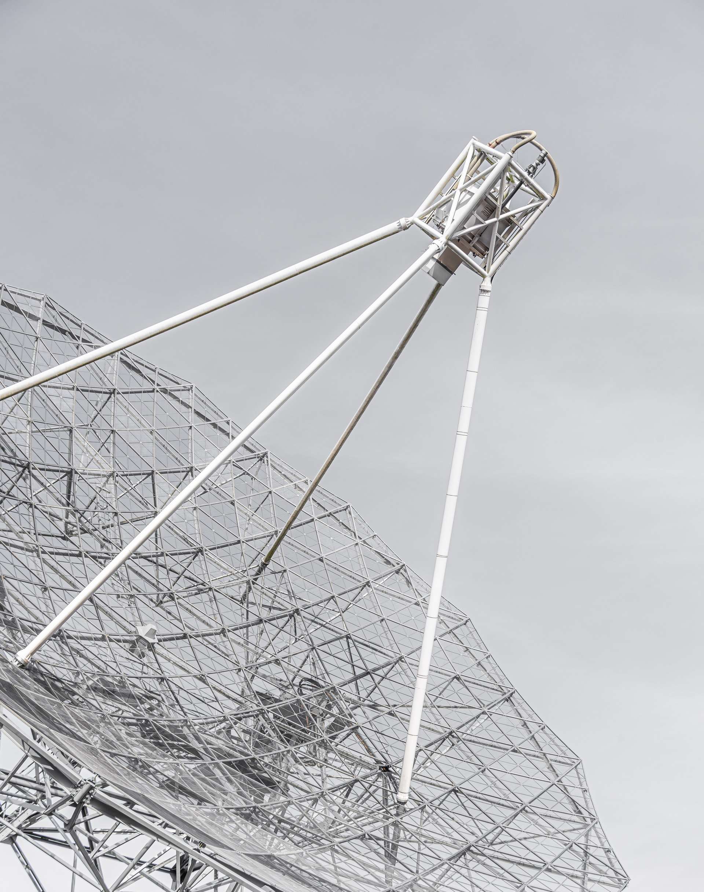
Introduction of DOA
Bartlett Algorithm
Capon Algorithm
MEM Algorithm
MUSIC Algorithm

Slide 5
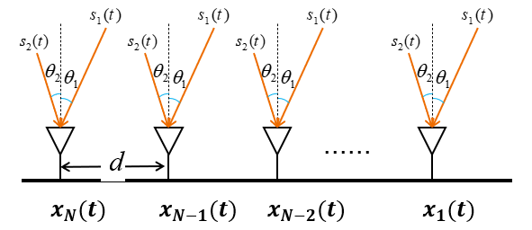
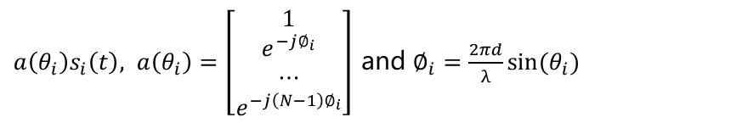
MUSIC Algorithm
$s\left(t\right)={[s_{1} \left(t\right),s_{2} \left(t\right),…,s_{D} \left(t\right)]}^{T}$ with AOA $\left\{θ_{1},θ_{2},…,θ_{D}\right\}$
The received signal inspired by $s_{i}(t)$ is
$a\left(θ_{i}\right)s_{i}\left(t\right), a\left(θ_{i}\right)=\left[\begin{matrix}1 \\ \begin{aligned}e^{−j∅_{i}} \\ ⋯\end{aligned} \\ e^{−j\left(N−1\right)∅_{i}}\end{matrix}\right]$ and $∅_{i}=\frac{2πd}{λ}sin⁡(θ_{i})$

Slide 6
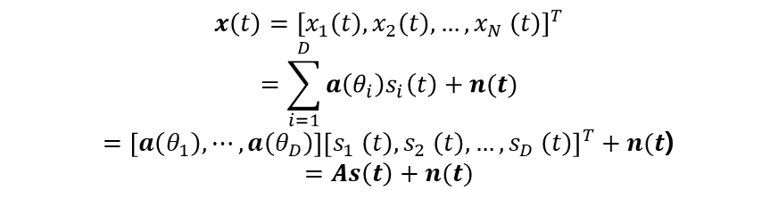
MUSIC Algorithm
The received signal is
$$x\left(t\right)={[x_{1}\left(t\right),x_{2}\left(t\right),…,x_{N} \left(t\right)]}^{T}$$
$$=\sum_{i=1}^{D}{a\left(θ_{i}\right)s_{i}\left(t\right)+n(t)}$$
$=\left[a\left(θ_{1}\right),⋯,a\left(θ_{D}\right)\right]{\left[s_{1} \left(t\right),s_{2} \left(t\right),…,s_{D} \left(t\right)\right]}^{T}+n(t$)
$$=As\left(t\right)+n(t)$$

Slide 7
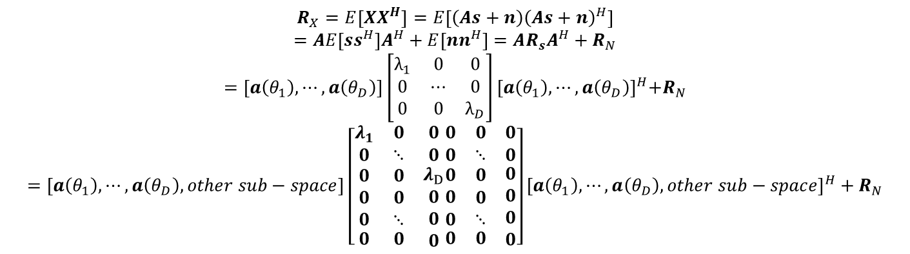
MUSIC Algorithm
The autocorrelation matrix of theoretically received signals can be written as:
$$R_{X}=E\left[XX^{H}\right]=E\left[\left(As+n\right){\left(As+n\right)}^{H}\right]$$
$$=AE\left[ss^{H}\right]A^{H}+E\left[nn^{H}\right]=AR_{s}A^{H}+R_{N}$$
$$=\left[a\left(θ_{1}\right),⋯,a\left(θ_{D}\right)\right]\left[\begin{matrix}λ_{1} & 0 & 0 \\ 0 & ⋯ & 0 \\ 0 & 0 & λ_{D}\end{matrix}\right]{[a\left(θ_{1}\right),⋯,a\left(θ_{D}\right)]}^{H}+R_{N}$$
$$=\left[a\left(θ_{1}\right),⋯,a\left(θ_{D}\right),other sub−space\right]\left[\begin{matrix}λ_{1} & 0 & 0 \\ 0 & ⋱ & 0 \\ \begin{aligned}\begin{aligned}0 \\ 0 \\ 0\end{aligned} \\ 0\end{aligned} & \begin{aligned}\begin{aligned}0 \\ 0 \\ ⋱\end{aligned} \\ 0\end{aligned} & \begin{aligned}λ_{D} \\ 0 \\ 0 \\ 0\end{aligned}\end{matrix}\begin{matrix}0 & 0 & 0 \\ 0 & ⋱ & 0 \\ \begin{aligned}\begin{aligned}0 \\ 0 \\ 0\end{aligned} \\ 0\end{aligned} & \begin{aligned}\begin{aligned}0 \\ 0 \\ ⋱\end{aligned} \\ 0\end{aligned} & \begin{aligned}0 \\ 0 \\ 0 \\ 0\end{aligned}\end{matrix}\right]{\left[a\left(θ_{1}\right),⋯,a\left(θ_{D}\right),other sub−space\right]}^{H}+R_{N}$$

Slide 8


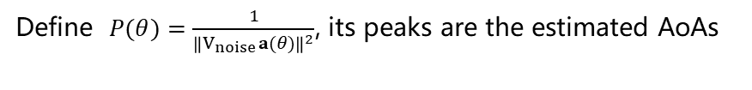
MUSIC Algorithm
The autocorrelation matrix of the actual received signal:
$$R_{X}≈\hat{R_{X}}=\frac{1}{T}\sum_{t=1}^{T}{x(t)}x^{H}(t)$$
The eigenvalue decomposition is performed :
$$R_{X}=\left[v_{1},v_{2},…,v_{N}\right]\left[\begin{matrix}λ_{1} & 0 & 0 \\ 0 & ⋱ & 0 \\ 0 & 0 & λ_{N}\end{matrix}\right]{\left[v_{1},v_{2},…,v_{N}\right]}^{H}$$
For incident signal angle 𝜃, $V_{noise}$𝐚(𝜃) could be very small
Define $P(θ)=\frac{1}{{\left\|V_{noise}a(θ)\right\|}^{2}}$, its peaks are the estimated AoAs

Slide 9
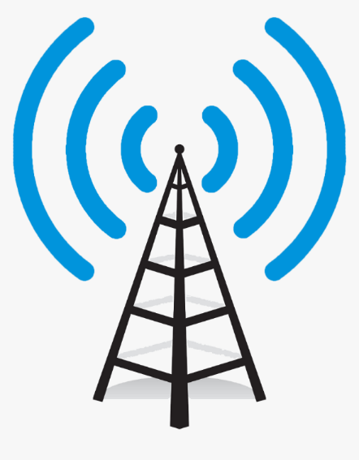

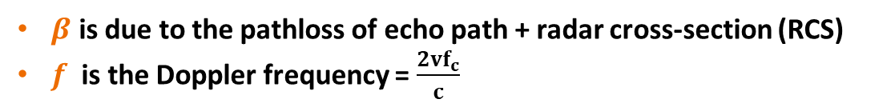
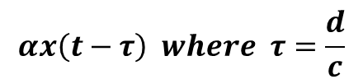
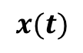
Doppler sensing
$$x(t)$$
$$αx\left(t−τ\right) where τ=\frac{d}{c}$$
Data Signals
Echo
$$αβx\left(t−2τ\right)e^{j2πft}$$
Velocity v
$β$ is due to the pathloss of echo path + radar cross-section (RCS)
$f$ is the Doppler frequency = $\frac{2vf_{c}}{c}$

Slide 10
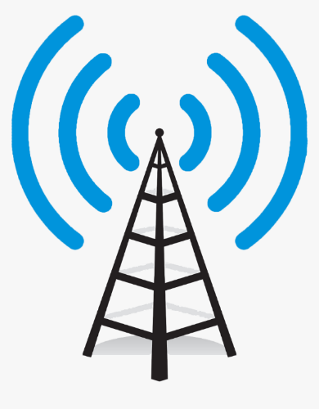


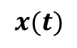
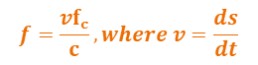

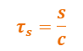
Doppler sensing
$$x(t)$$
$$τ_{s}=\frac{s}{c}$$
$$f=\frac{vf_{c}}{c}, where v=\frac{ds}{dt}$$
$$s$$
Surveillance Channel
Reference Channel
$$y_{r}\left(t\right)=αx\left(t−τ_{r}\right)$$
$$y_{s}\left(t\right)= βx\left(t−τ_{s}\right)e^{j2πft}$$
Passive Receiver

Slide 11
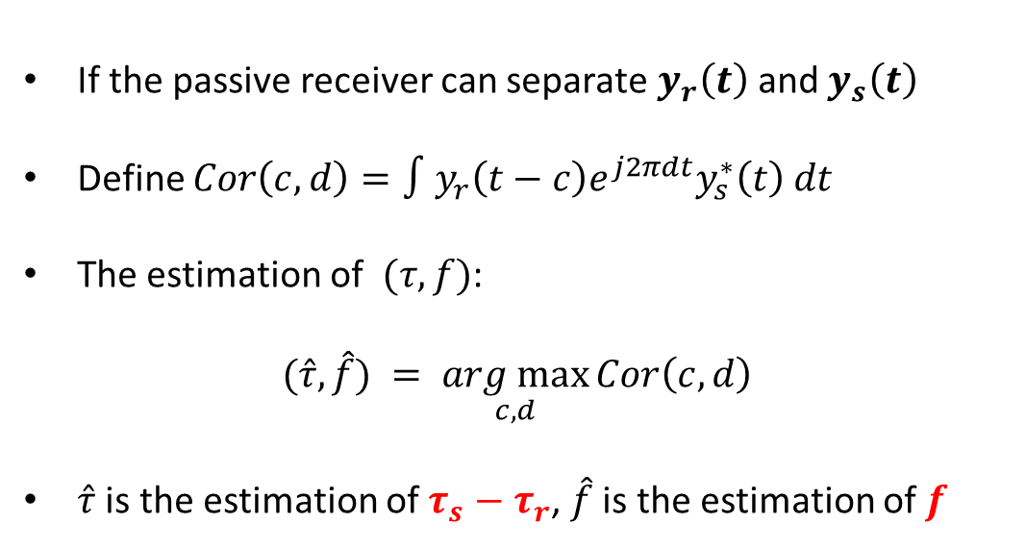
Doppler sensing
If the passive receiver can separate $y_{r}\left(t\right)$ and $y_{s}\left(t\right)$
Define $Cor\left(c,d\right)=∫y_{r}\left(t−c\right)e^{j2πdt}y_{s}^{∗}\left(t\right) dt$
The estimation of $(τ,f)$:
$$(\hat{τ},\hat{f}) = \underset{c,d}{arg max}{Cor\left(c,d\right)}$$
$\hat{τ}$ is the estimation of $τ_{s}−τ_{r}$, $\hat{f}$ is the estimation of $f$
$$y_{r}\left(t\right)=αx\left(t−τ_{r}\right)$$
Ambiguity Function
$$y_{s}\left(t\right)= βx\left(t−τ_{s}\right)e^{j2πft}$$

Slide 12


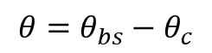
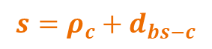
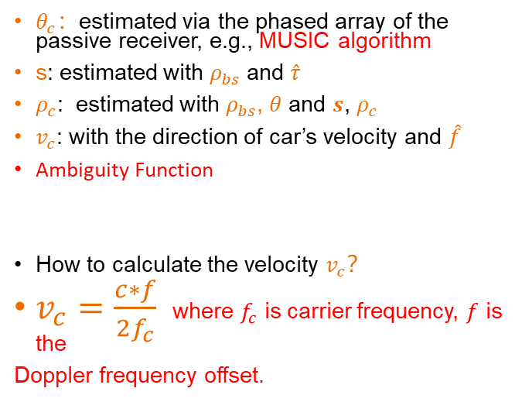
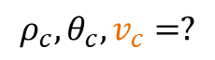
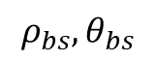
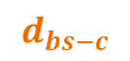
Doppler sensing
$θ_{c}$：estimated via the phased array of the passive receiver, e.g., MUSIC algorithm
s: estimated with $ρ_{bs}$ and $\hat{τ}$
$ρ_{c}$: estimated with $ρ_{bs}$, $θ$ and $s$, $ρ_{c}$
$v_{c}$: with the direction of car’s velocity and $\hat{f}$
Ambiguity Function
How to calculate the velocity $v_{c}$？
$v_{c}=\frac{c∗f}{2f_{c}}$ where $f_{c}$ is carrier frequency, $f$ is the
Doppler frequency offset.
$$s=ρ_{c}+d_{bs−c}$$
$$d_{bs−c}$$
$$ρ_{bs},θ_{bs}$$
$$ρ_{c},θ_{c},v_{c}=?$$
$$θ=θ_{bs}−θ_{c}$$

Slide 13
02
PART
MATLAB Code

Slide 14
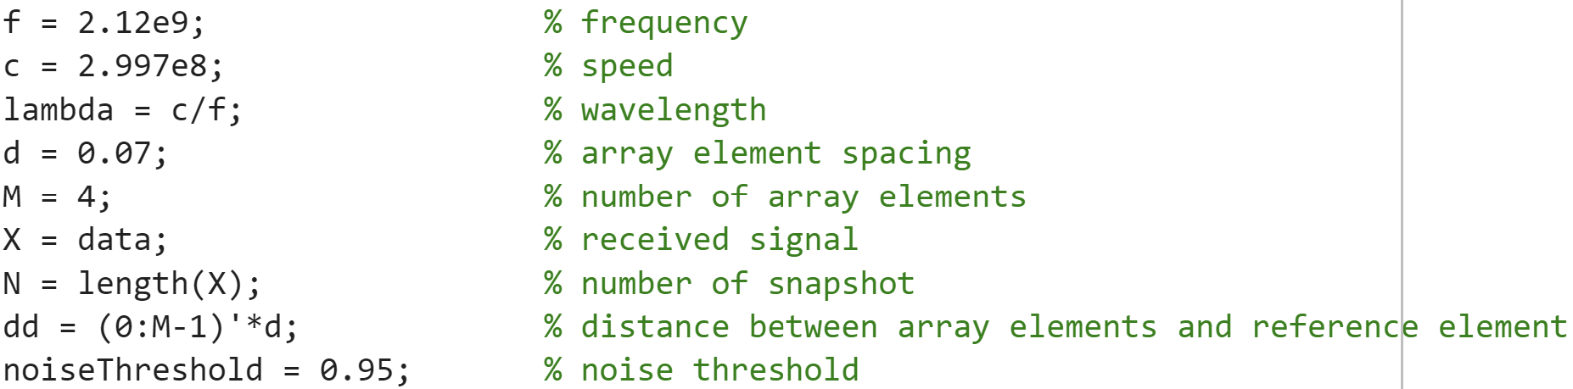
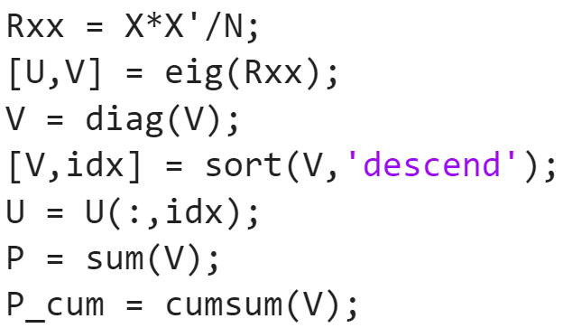
MUSIC
Initialize parameters
Calculate covariance matrix
Eigenvalue decomposition
Arrange the eigenvalues of Rx in descending order
Arrange corresponding eigenvectors in corresponding order
Calculate the sum of the eigenvalues
Create cumulative array of eigenvalues
EE312: Design of Modern Communication Systems
14

Slide 15
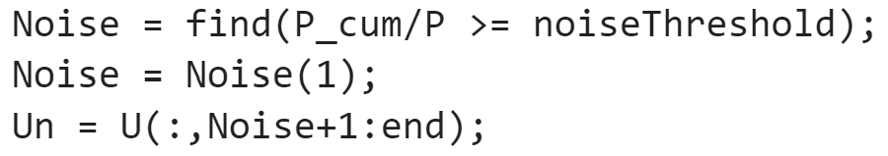
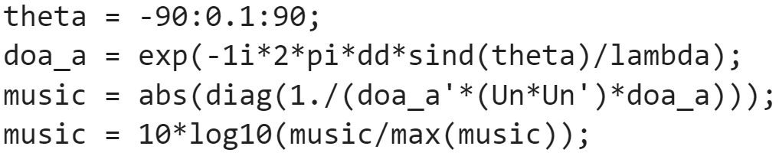
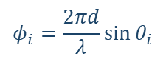
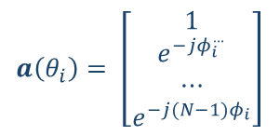
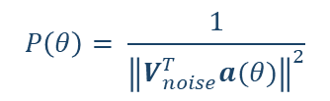
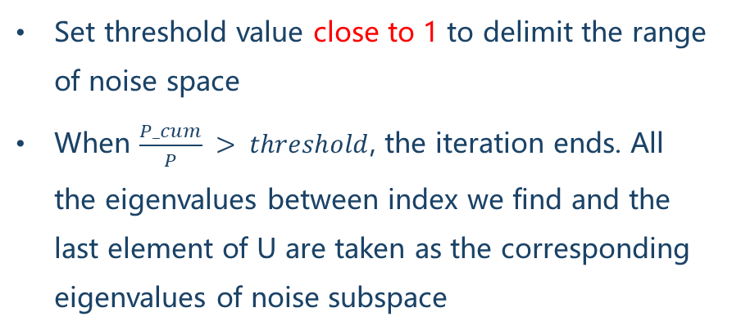
MUSIC
Set threshold value close to 1 to delimit the range of noise space
When $\frac{P_cum}{P} > threshold$, the iteration ends. All the eigenvalues between index we find and the last element of U are taken as the corresponding eigenvalues of noise subspace
$$a\left(θ_{i}\right)= \left[\begin{matrix}1 \\ e^{−jφ_{i}^{…}} \\ ⋯ \\ e^{−j(N−1)φ_{i}}\end{matrix}\right]$$
$$φ_{i}=\frac{2πd}{λ}\sin{θ_{i}}$$
$$P\left(θ\right)= \frac{1}{{\left\|V_{noise}^{T}a(θ)\right\|}^{2}}$$
EE312: Design of Modern Communication Systems
15

Slide 16
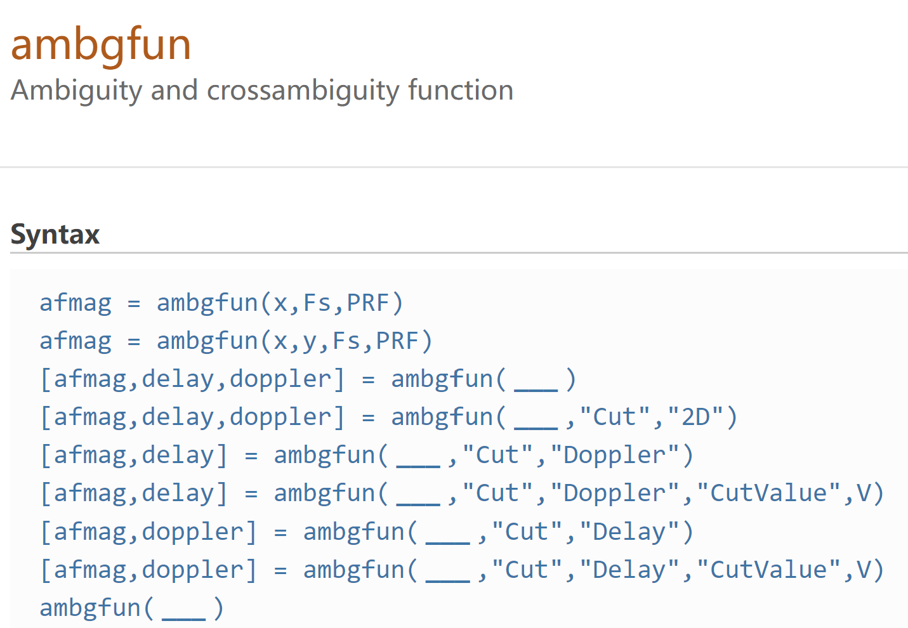
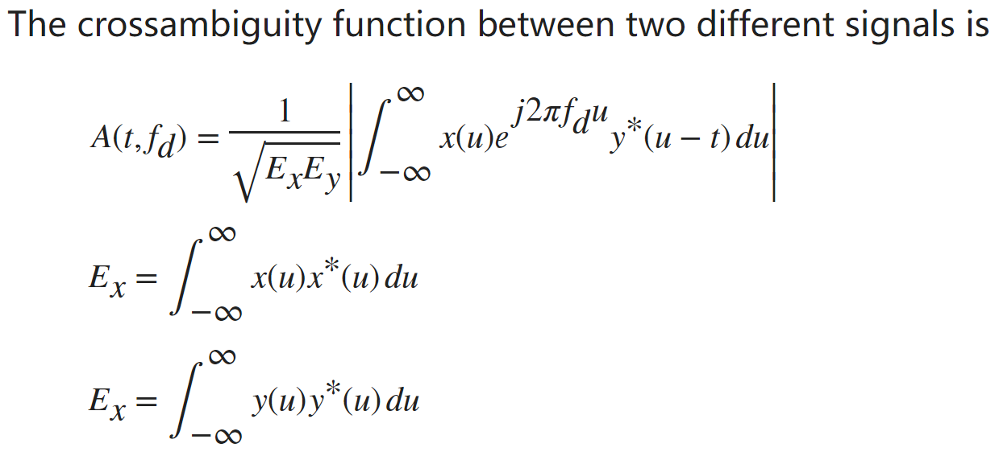
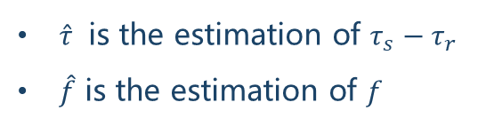

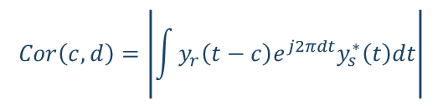
Ambiguity Function
$$Cor\left(c,d\right)=\left|\int{y_{r}\left(t−c\right)e^{j2πdt}y_{s}^{∗}\left(t\right)dt}\right|$$
$$\left(\hat{τ},\hat{f}\right)=\underset{c,d}{arg max}{Cor\left(c,d\right)}$$
$\hat{τ}$ is the estimation of $τ_{s}−τ_{r}$
$\hat{f}$ is the estimation of $f$
EE312: Design of Modern Communication Systems
16

Slide 17
03
PART
Experiment

Slide 18
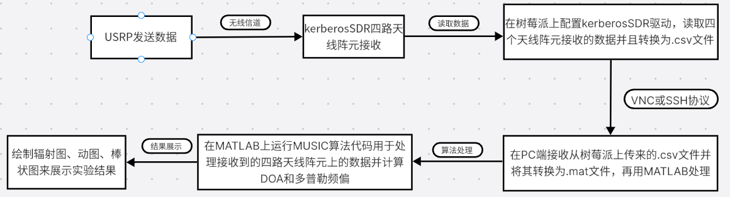
Experimental Platform
Framework diagram of physical experiment system
EE312: Design of Modern Communication Systems
18

Slide 19
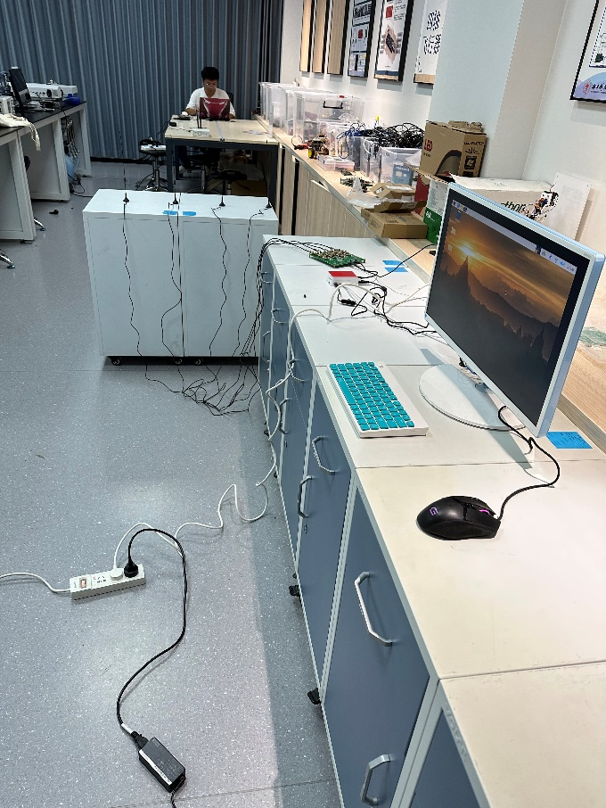
Experimental Platform
实地搭建场景图
EE312: Design of Modern Communication Systems
19

Slide 20
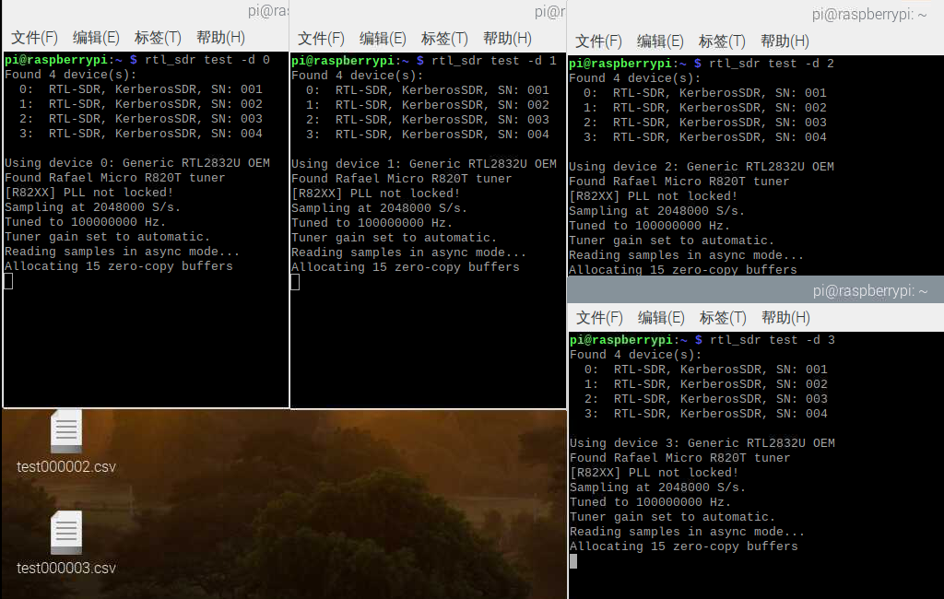
Experimental Platform
在树莓派上配置KerberosSDR驱动
上图表示树莓派已成功读取到天的数据
EE312: Design of Modern Communication Systems
20

Slide 21
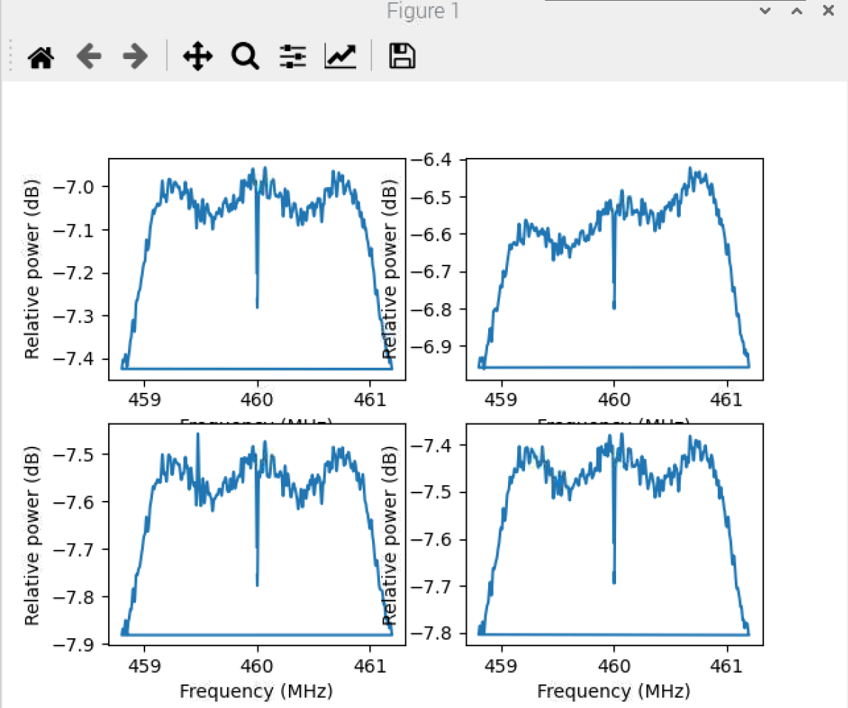
Experimental Platform
树莓派捕获USRP发射的信号后将生成四个天线对应的波形图，上图为不加任何挡板时的实验结果
EE312: Design of Modern Communication Systems
21

Slide 22
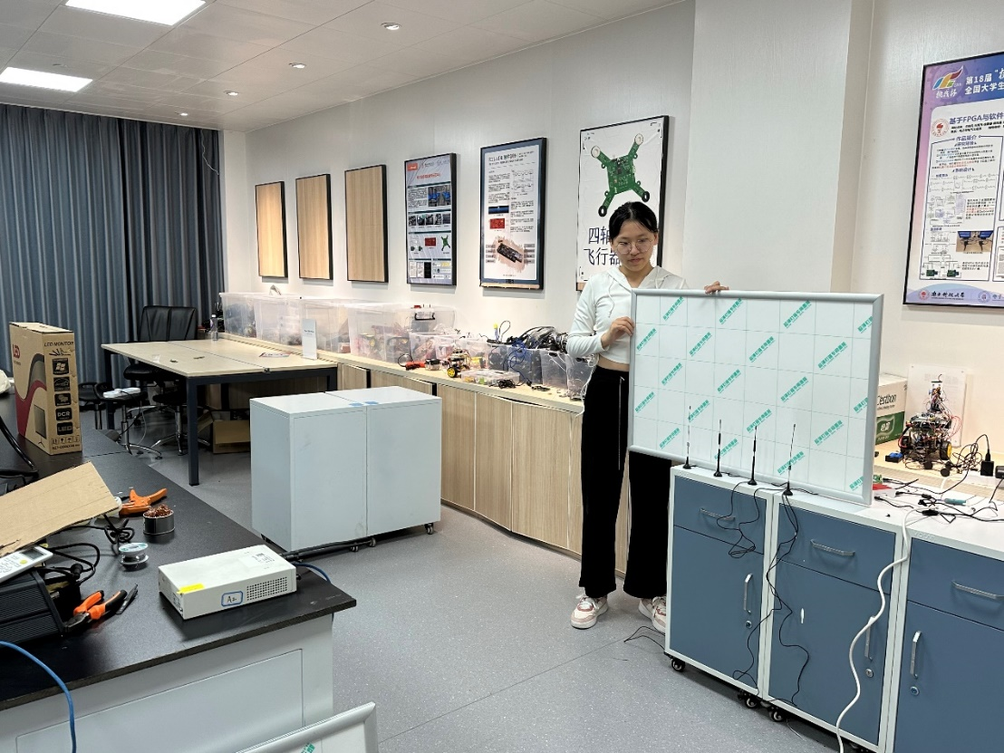
Experimental Platform
设计优化实验1
EE312: Design of Modern Communication Systems
22

Slide 23
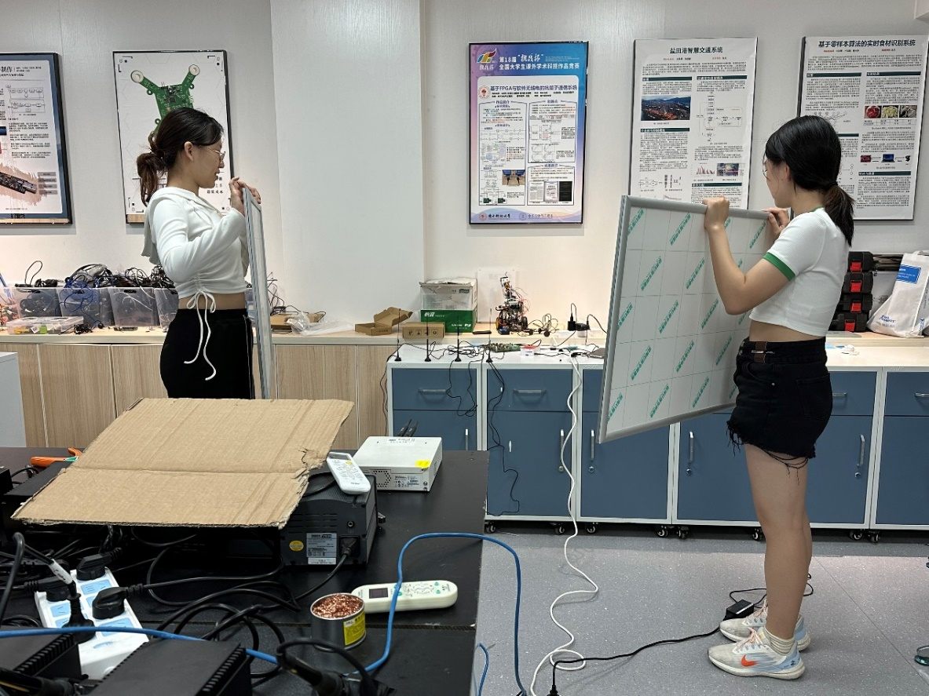
Experimental Platform
设计优化实验2
EE312: Design of Modern Communication Systems
23

Slide 24
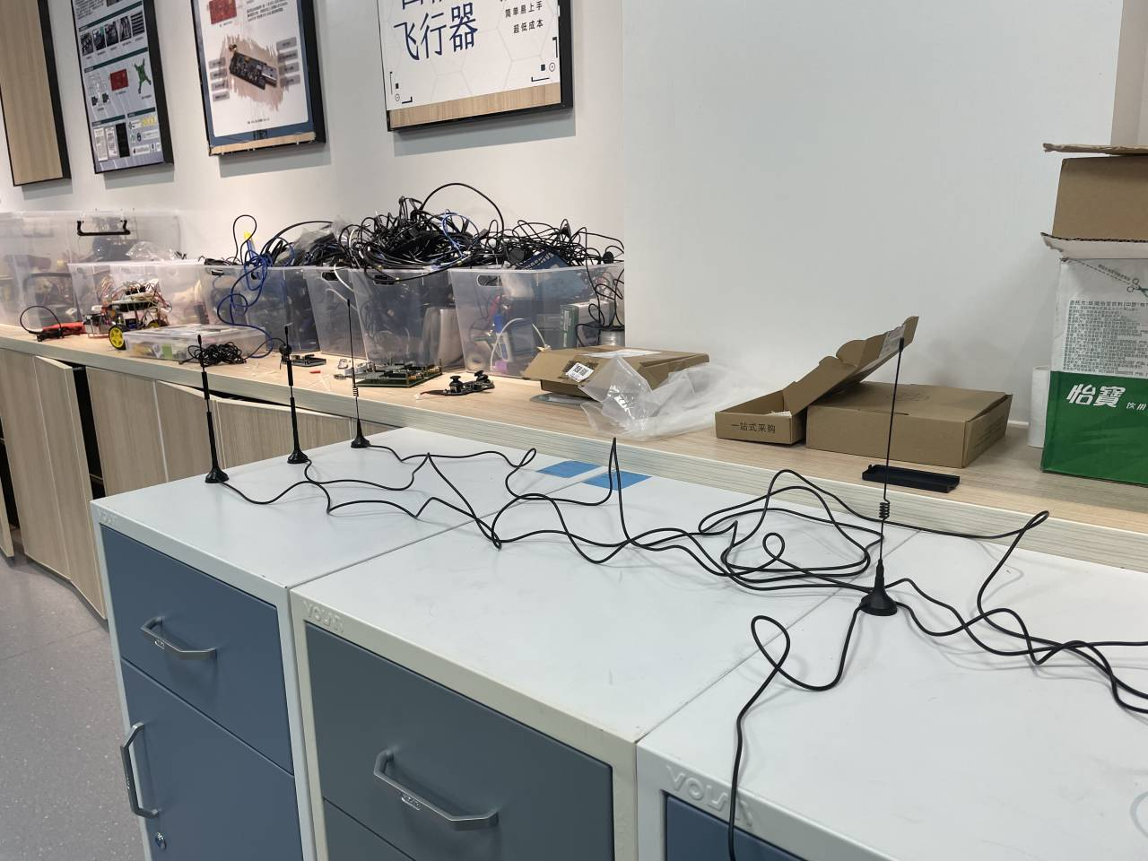
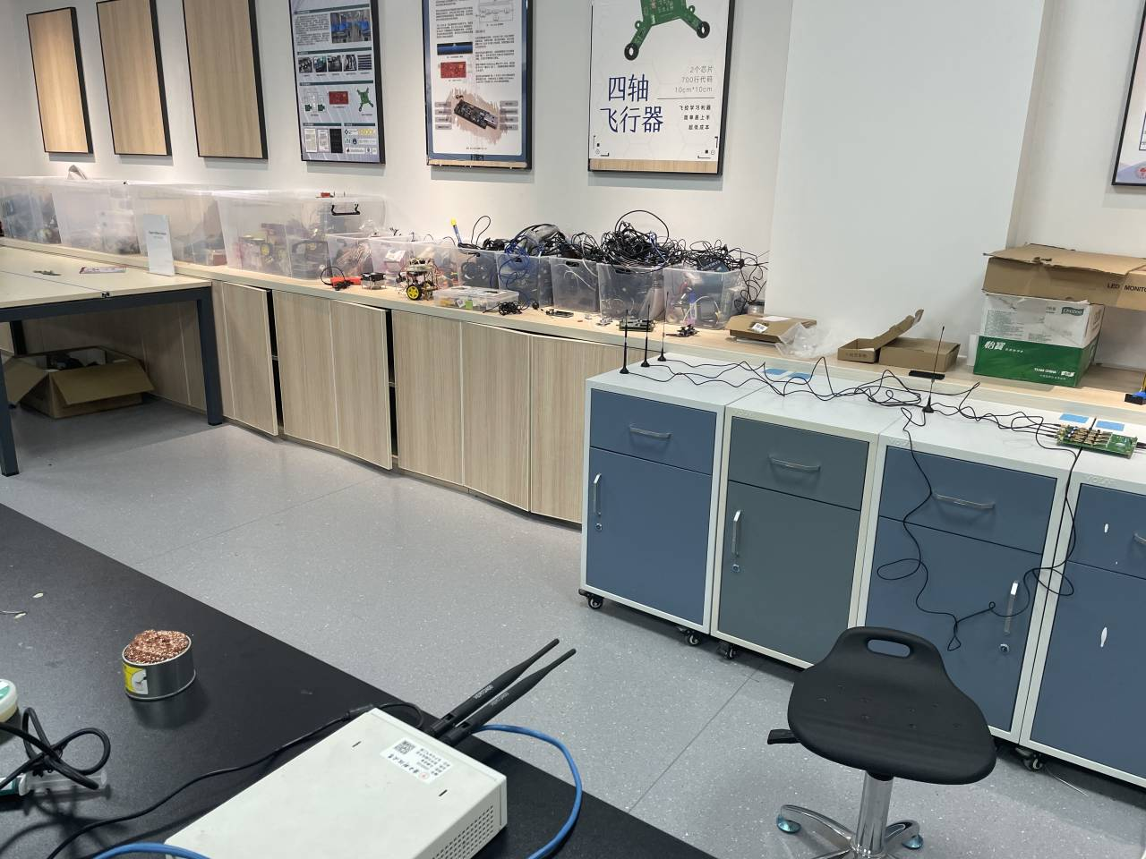

Experimental Platform
$$v$$
多普勒雷达感知实验
左侧： Surveillance Channel Antenna
右侧：Reference Channel Antenna
EE312: Design of Modern Communication Systems
24

Slide 25
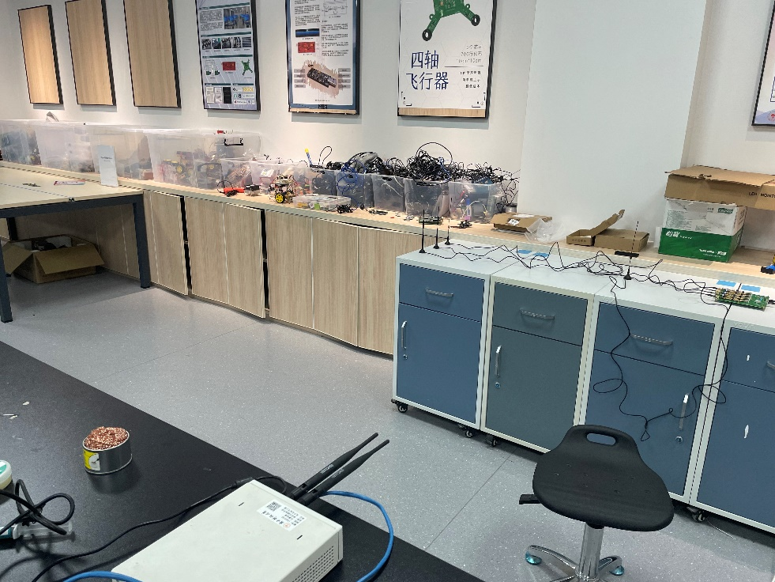
Experimental Platform
多普勒雷达感知实验
左侧： Surveillance Channel Antenna
右侧：Reference Channel Antenna
EE312: Design of Modern Communication Systems
25

Slide 26
04
PART
Results & Analysis

Slide 27
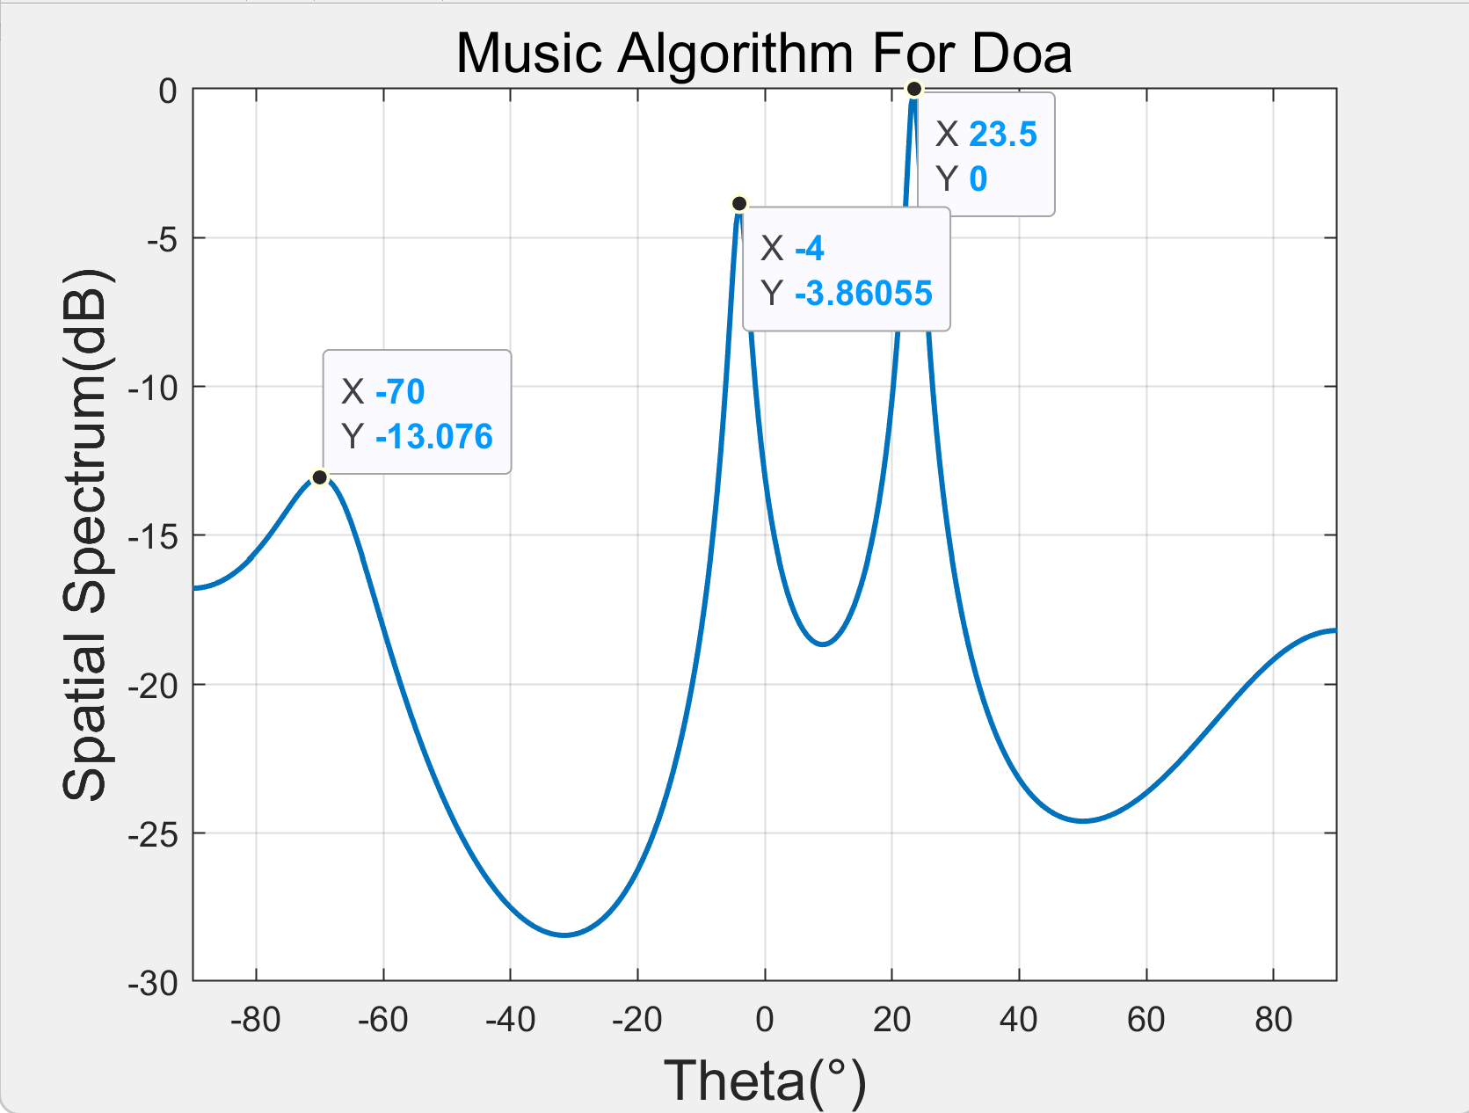
Pre-recorded data recovery
EE312: Design of Modern Communication Systems
27

Slide 28
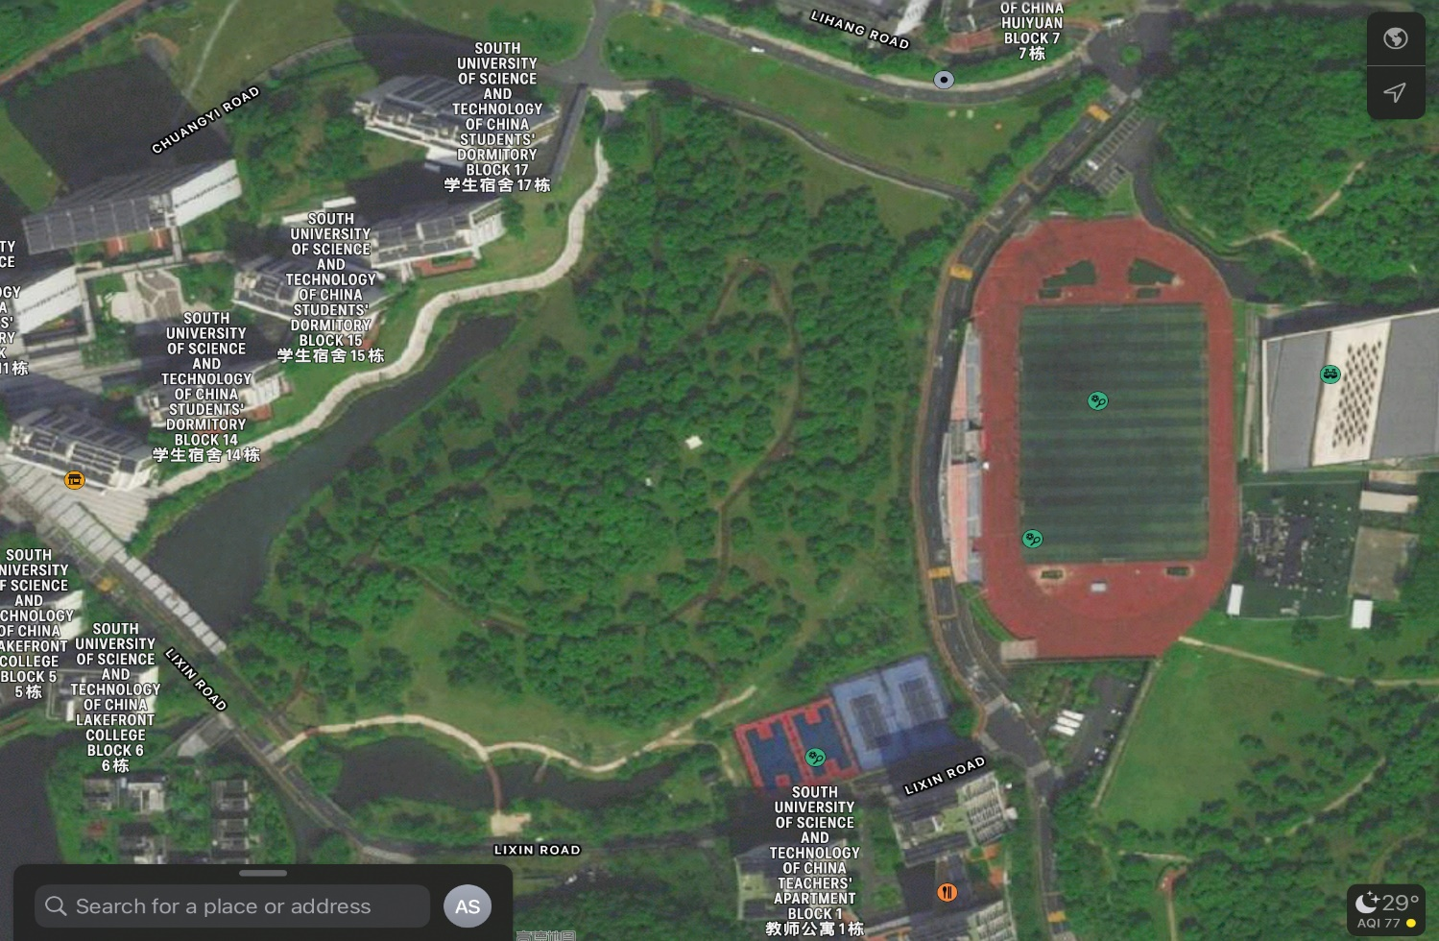
Pre-recorded data recovery
Tx
Rx
EE312: Design of Modern Communication Systems
28

Slide 29
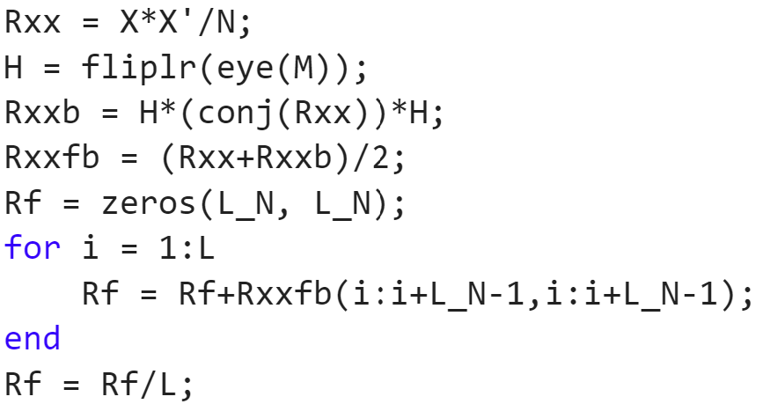
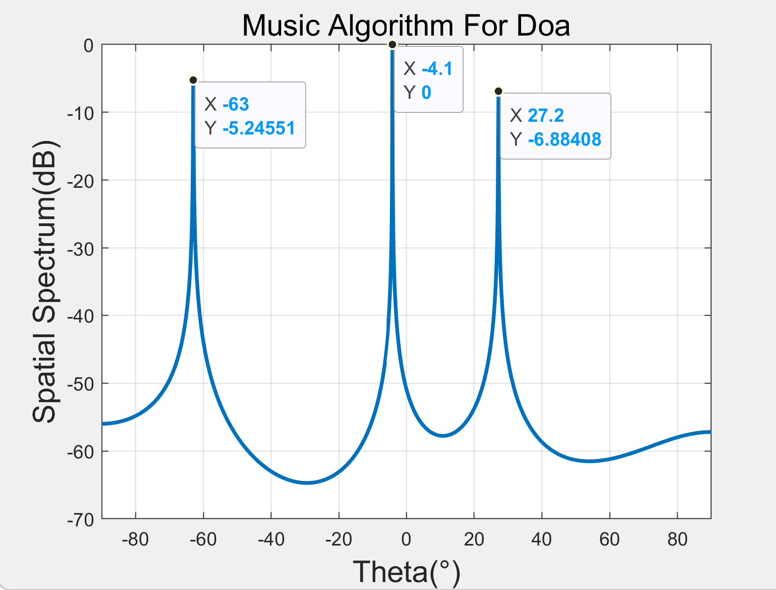
Pre-recorded data recovery
Backward spatial smoothing (BSS)
Better resolution of multiple coherent signals
https://blog.csdn.net/qq_36583373/article/details/109382579
EE312: Design of Modern Communication Systems
29

Slide 30
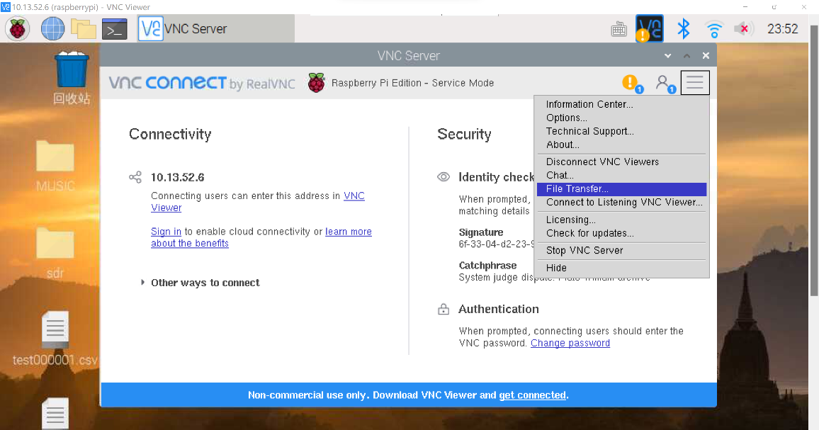
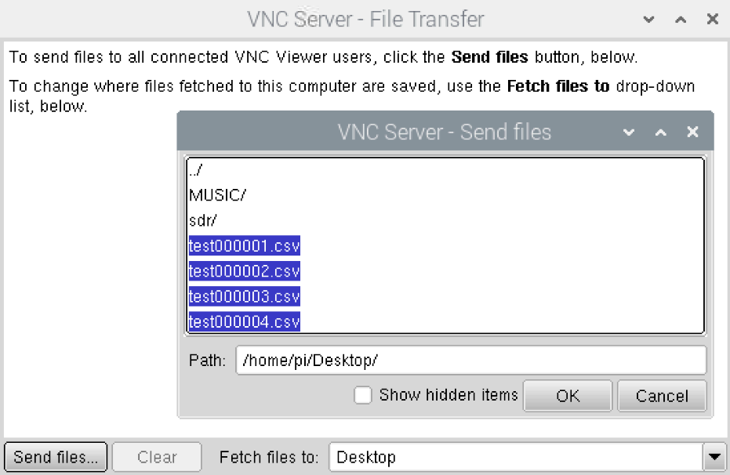
Data processing
VNC Viewer
EE312: Design of Modern Communication Systems
30

Slide 31






Data processing
EE312: Design of Modern Communication Systems
31

Slide 32


MATLAB simulation results - Original music algorithm
Incoherent signals
Coherent signals
EE312: Design of Modern Communication Systems
32

Slide 33


MATLAB simulation results - smoothing algorithm
Forward spatial
Backward spatial s
EE312: Design of Modern Communication Systems
33

Slide 34



DOA Estimation
Our first experiment was to simply place the receiving antenna array element opposite the USRP.
The signal transmitted by USRP is oriented in all directions, maybe some signals in the opposite direction are cancelled, but more signals still enter the receiver.
EE312: Design of Modern Communication Systems
34

Slide 35


DOA Estimation
We added reflective surfaces on both sides to block part of the scattered signal
The number of peak angle detected is less than the first experiment
The range of peak angles detected is larger than in the first experiment
EE312: Design of Modern Communication Systems
35

Slide 36

DOA Estimation
Since we didn't find a spacious open space, we couldn't isolate the reflection of surrounding objects. So we looked for a set of data measured in an open field online and processed it.
EE312: Design of Modern Communication Systems
36

Slide 37

Doppler frequency bias
Since we didn't find a spacious open space, we couldn't isolate the reflection of surrounding objects. So we looked for a set of data measured in an open field online and processed it.
EE312: Design of Modern Communication Systems
37

Slide 38
05
PART
Conclusions

Slide 39
Summary
Basic task
Understand DOA algorithms and hardware capabilities
Simulation implementation of the music algorithm
Use SDR to receive measurement position information
Exploration
Pre-recorded data recovery and analysis
Exploration of the Doppler shift
EE312: Design of Modern Communication Systems
39
Notes:
中国的UWB标准采用了OFDM双载波技术,包含两个载波的OFDM超宽带信号进行数据传输
数字音频广播 (DAB)
HiperLAN是一种在欧洲应用的无线局域网通讯标准的一个子集

Slide 40
Experience
When building physical devices, we need to test each device separately before connecting it, in case there are experimental problems that arise later
Understand the hardware specifications first. Each device has different requirements. For example, the maximum frequency of the signal that Kerberos SDR can receive is only 1.75GHz. The center frequency we set at the beginning is higher than this value, so the signal cannot be received.
Follow-up analysis where the experimental results do not match the theory
Arrange the time of the experiment, the importance of the experimental site
EE312: Design of Modern Communication Systems
40
Notes:
中国的UWB标准采用了OFDM双载波技术,包含两个载波的OFDM超宽带信号进行数据传输
数字音频广播 (DAB)
HiperLAN是一种在欧洲应用的无线局域网通讯标准的一个子集

Slide 41
Experience
When testing the connections of the antennas, we just tested one antenna at the first time, and there is an error which took us a lot of time to debug. However, when testing all four antennas together, we found that when we started testing the third antenna, the connection was aborted. Therefore, we finally found the problem for that is the power supply of SDR is insufficient so that we cannot drive all four antennas simultaneously.
When using MUSIC algorithm to estimate DOA, it should be noticed that the number of receiving antennas must be more than the number of received signals. So we can conclude that MUSIC algorithm cannot be used in situations where there are large number of received signals (large number of scatters).
EE312: Design of Modern Communication Systems
41
Notes:
中国的UWB标准采用了OFDM双载波技术,包含两个载波的OFDM超宽带信号进行数据传输
数字音频广播 (DAB)
HiperLAN是一种在欧洲应用的无线局域网通讯标准的一个子集

Slide 42
Q&A

Slide 43
THANKS

